Slide 1
Lecture-2
Chapter-18
Melting: This is the process of changing a substance from the solid state to the liquid state.
The reverse of melting is freezing.
Vaporizing: This is the process of changing a substance from the liquid state to the vapor (gas) state.
The reverse of vaporizing is condensing.

Slide 2
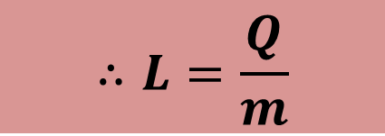
Heat of Transformation: The amount of energy per unit mass that must be transferred as heat when a sample completely undergoes a phase change is called the heat of transformation L.
$$∴L=\frac{Q}{m}$$

Slide 3
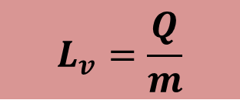
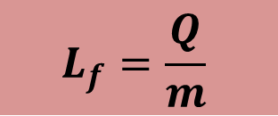
Latent heat of fusion: The amount of heat energy per unit mass to change the phase of an object from solid to liquid is called the latent heat of fusion.
$$L_{f}=\frac{Q}{m}$$
Unit: J/Kg or cal/gm.
Latent heat of vaporization: The amount of heat energy per unit mass to change the phase of an object from liquid to gas is called the latent heat of vaporization.
$$L_{v}=\frac{Q}{m}$$
Unit: J/Kg or cal/gm.

Slide 4
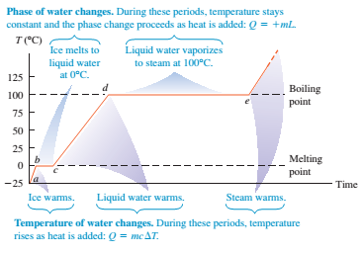

Slide 5

Transfer of Energy as heat and work
Let us consider a system as a gas confined to a cylinder with a movable piston.
The walls of the cylinder are made of insulating material. The bottom of the cylinder rests on a reservoir for thermal energy, a thermal reservoir(perhaps a hot plate) whose temperature T can be controled by turning a knob.

Slide 6
The system starts from an initial state i, described by a pressure p_{i} , a volume V_{i} and a temperature T_{i} . The system is changed to a final state f, described by a pressure p_{f} ,a volume V_{f} ,and a temperature T_{f} .The procedure by which the system changes from its initial state to its final state is called a thermodynamic process.
During such a process, energy may be transferred into the system from the thermal reservoir (positive heat) or vice versa (negative heat).
Also, work can be done by the system to raise the piston (positive work) or lower it (negative work)

Slide 7
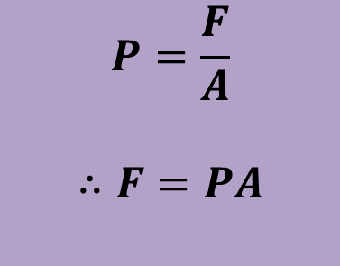
Work Done By Ideal Gas at Constant Pressure
Consider an ideal gas is in a cylinder with a piston.
ds
We move the piston upward by a small displacement ds allowing the gas to apply a force F on the piston.
Let, P is the pressure of the gas and A is the face area of the piston.
$$P=\frac{F}{A}$$
$$∴F=PA$$

Slide 8
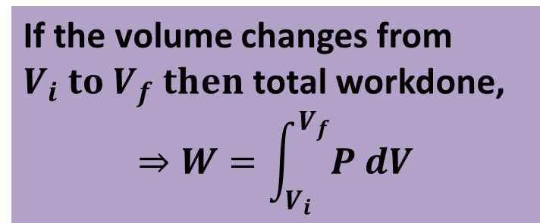
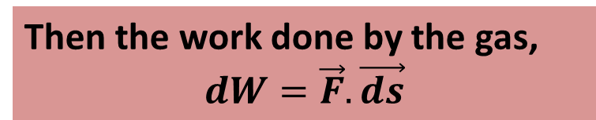



Then the work done by the gas,
$$dW=\vec{F}.\vec{ds}$$
$$⇒dW=\left(PA\right)ds$$
$$⇒dW=P(Ads)$$
$$⇒dW=P dv$$

Slide 9
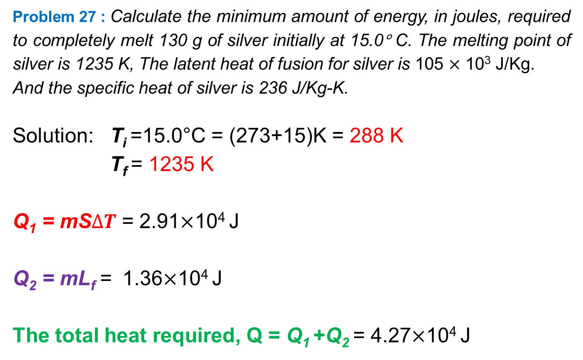
Problem 27 : Calculate the minimum amount of energy, in joules, required to completely melt 130 g of silver initially at 15.0° C. The melting point of silver is 1235 K, The latent heat of fusion for silver is 105 $×$ 10³ J/Kg.
And the specific heat of silver is 236 J/Kg-K.
Solution: T_{i} =15.0°C = (273+15)K = 288 K
T_{f} = 1235 K
Q₁ = mS$∆T$= 2.91$×$10⁴ J
Q₂ = mL_{f} = 1.36$×$10⁴ J
The total heat required, Q = Q₁ +Q₂ = 4.27$×$10⁴ J

Slide 10
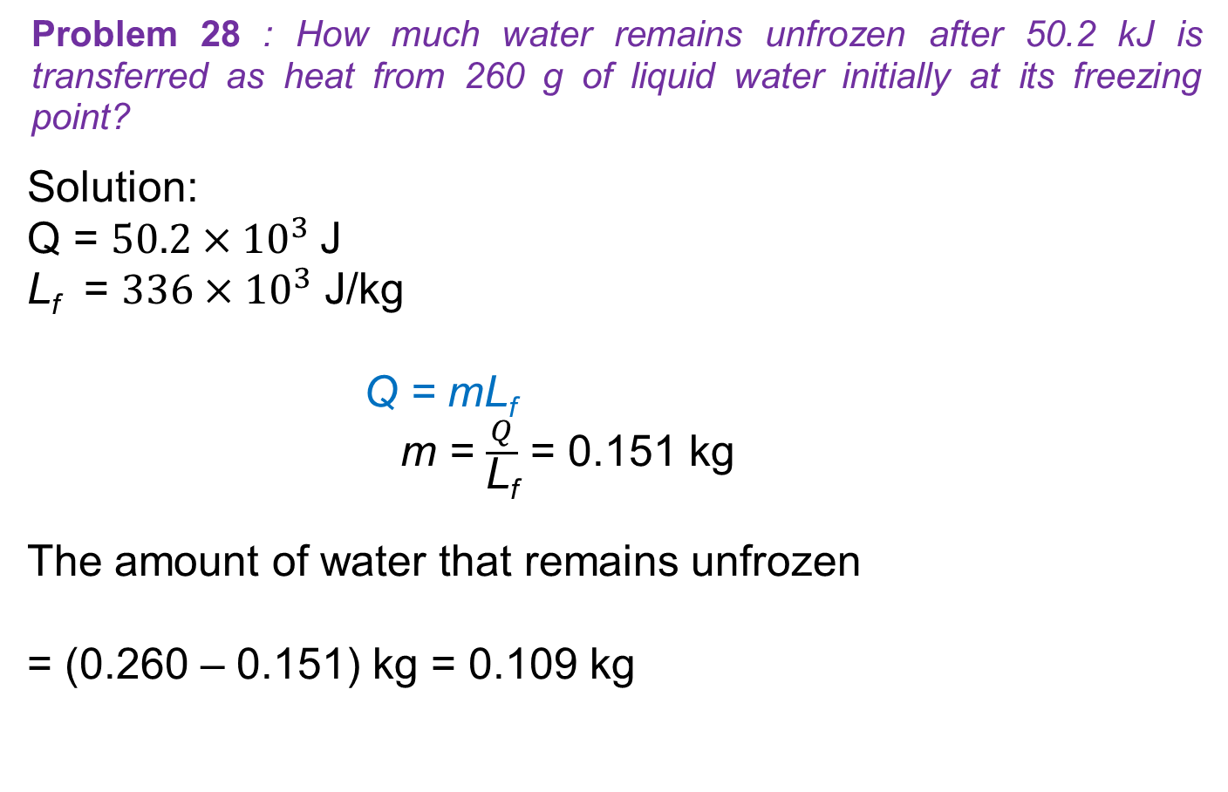
Problem 28 : How much water remains unfrozen after 50.2 kJ is transferred as heat from 260 g of liquid water initially at its freezing point?
Solution:
Q = $50.2{×10}^{3}$J
L_{f} = $336{×10}^{3}$ J/kg
Q = mL_{f}
m = $\frac{Q}{\text{L}\text{f}}$ = 0.151 kg
The amount of water that remains unfrozen
= (0.260 – 0.151) kg = 0.109 kg

